Slide 1
Genpact Proposal
GE Gas Power
December 2022

Slide 2
Profiles

Slide 3
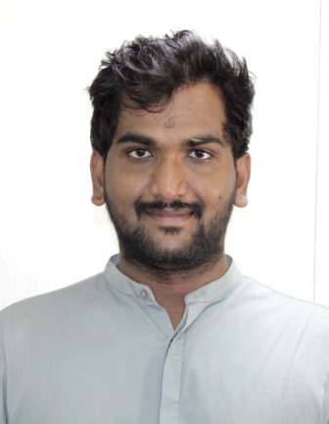
Punugoti Nagarjuna Reddy
Consultant
Linux| Python | Ansible | Ansible Tower| AWS | Terraform | Docker |Shell Scripting | Jenkins |API
Skill Set:
Python Scripting
Ansible
Jenkins
AWS Cloud services
REST API
Jenkins
Terraform
Linux
IDE like VS code
Snapshot
Having 5.2 years of experience in Telecom and Power&Energy domain by using technologies like Python, Ansible, Linux, Jenkins, Terraform, Application Maintenance using Software Development life cycle and Agile methodology. Having experience in Devops Process and automating infrastructure.
Professional Summary
Collaborate with stakeholders to understand business Requirement and convert them into Epic, features, and user stories
Worked as an individual contributor Linux and Infra maintenance in Telecom Domain for Product Using Methodology SDLC(Software Development Life Cycle)
Worked on Cloud Automations Ansible, Python ,AWS cloud and Linux maintenance
Provided Services like Development/Application Telecom Domain projects based on various Devops Process tools and technologies
Experienced in writing Python scripting for automating AWS Cloud infrastructure
Requirement gathering, Analysis of requirement. Finalizing the requirement by interacting with clients
Performed development keeping in mind code reusability, code clean up
Unit Testing, Manual Deployment in servers. Providing support in QA testing
Analyses of ticket which comes for IT Research and doing the development and enhancement as per the requirement
Developed Python scripts to automate the data collection process from REST API and reduced manual effort by 100%
Used Ansible to install and configure LDAP on multiple servers, with crash proof strategies
Worked on Ansible Tower ,to automate LDAP installation through AWS lambda and python
Created Ansible playbooks to automatically install packages from a repository, to change the configuration of remote machines and to deploy new builds
Experience in providing QA support during the QA testing
Experienced with event-driven and scheduled AWS Lambda functions to trigger various AWS resources
Education and Certification:
M.Tech.(Avionics)
Expertise:
Project Development
Ansible Cloud automation
Maintenance
Key Project:
Linux Server Administration
AWS Cloud Automations
Notes:
Profile 2

Slide 4

Thank You
Thank you

